Slide 1

CAPSTONE PROJECT
PROJECT TITLE
Presented By:
1. KARTHIKEYEN S - College Of Engineering, Guindy - B.E (CSE)

Slide 2
OUTLINE
Problem Statement
Proposed System/Solution
System Development Approach
Algorithm & Deployment
Result
Conclusion
Future Scope
References

Slide 3
Problem Statement
In today's digital age, where cybersecurity threats loom large, one of the significant concerns is the proliferation of keyloggers, stealthy software tools designed to monitor and record keystrokes on a user's computer without their knowledge. Keyloggers pose a severe threat to individuals and organizations as they can capture sensitive information such as passwords, credit card details, and other personal data, leading to identity theft, financial loss, and privacy breaches.

Slide 4
Proposed Solution
The proposed system aims to tackle the challenge of detecting and preventing keylogger threats effectively. This involves implementing advanced detection mechanisms and response strategies to safeguard users' sensitive information. The solution will comprise the following components:
Detection Mechanism:
Develop sophisticated algorithms to continuously monitor system activities and identify suspicious behavior indicative of keylogging activities.
Utilize machine learning and behavioral analysis techniques to establish baseline user behavior and detect deviations that may indicate the presence of a keylogger.
Real-time Alerting and Response:
Integrate a responsive alerting system to notify users and administrators upon detection of keylogging activities, enabling prompt investigation and mitigation of security threats.
Implement secure input handling mechanisms at the application level to prevent keylogger interception of sensitive information, including encryption of keystrokes during transmission and secure password entry dialogs.
Continuous Monitoring and Updates:
Establish a framework for continuous monitoring and updating of the keylogger detection system to adapt to evolving threats and vulnerabilities.
Deploy regular updates and patches to enhance detection capabilities and address emerging security challenges effectively.
Evaluation:
Assess the system's performance using appropriate metrics such as detection accuracy, false positive rate, and response time.
Conduct thorough testing and validation to ensure the reliability and effectiveness of the keylogger detection system in real-world scenarios.
Result:

Slide 5
System Approach
System Requirements:
Software Requirements:
Python 3.x environment
tkinter library for GUI development
pynput library for capturing keyboard events
Hardware Requirements:
Standard computer or laptop with compatible operating system (Windows, macOS, Linux)
Library Required:
tkinter: Used for GUI development to create the application's user interface.
pynput: Required for capturing keyboard events and implementing keylogging functionality.

Slide 6
Algorithm & Deployment
Algorithm Selection:
Chosen Algorithm: Keystroke Logging.
Justification: Keystroke logging is employed to capture and record keyboard events in real-time, aligning with the project's objective of developing a keylogger application.
Data Input:
Input Features: Keyboard events, including key presses, releases, and holds, are captured and logged by the keylogger application.
Training Process:
Training Data: No training process is required for the keylogger application, as it operates based on capturing keyboard events in real-time.
Prediction Process:
Prediction Method: The keylogger application continuously monitors keyboard activities and logs them in real-time, providing insights into user input behavior and patterns
Real-Time Inputs: The keylogger application captures keyboard events as they occur, enabling real-time monitoring and logging of user keystrokes.
By leveraging keystroke logging technology, the keylogger application effectively captures and logs keyboard events, providing valuable insights into user input behavior and enhancing security monitoring capabilities.

Slide 7
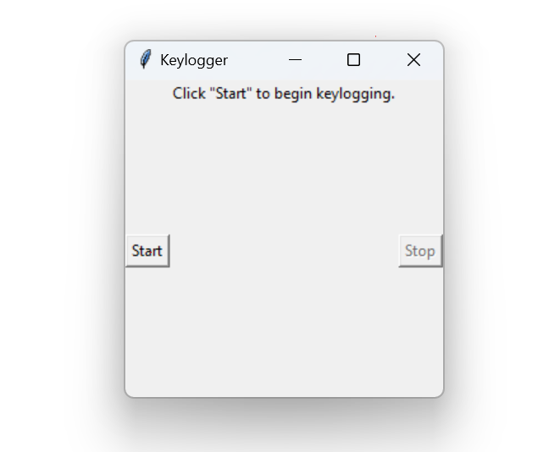
Result
The keylogger application successfully captures and logs keyboard events in real-time, providing insights into user input behavior and patterns.

Slide 8
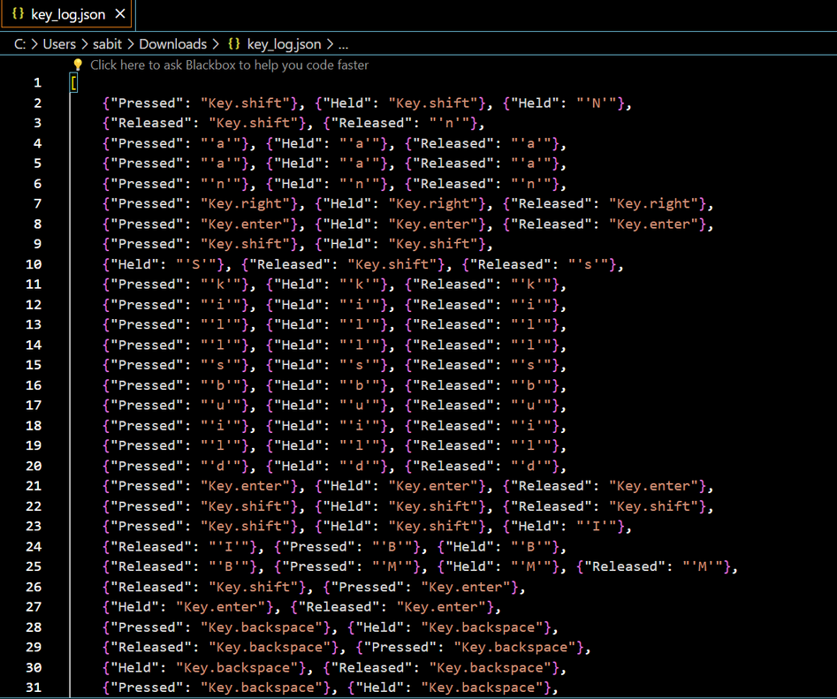
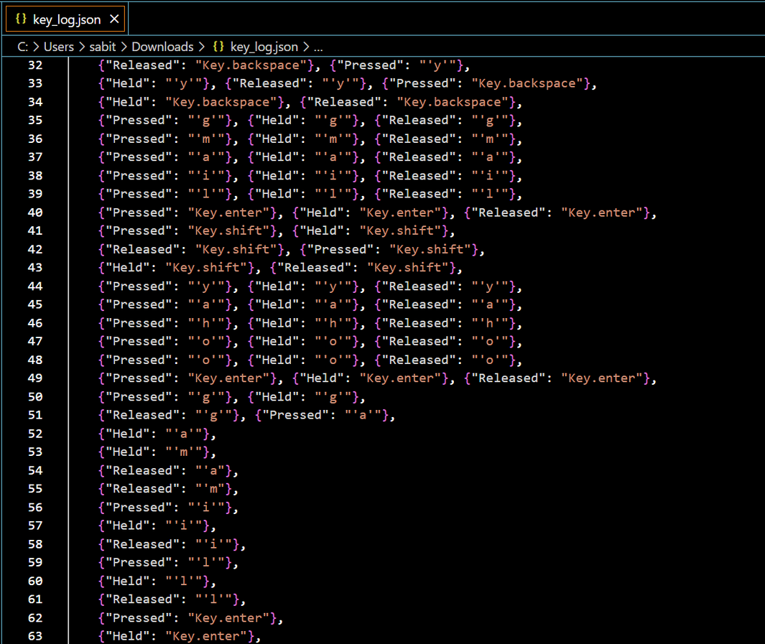
Key_log json file

Slide 9
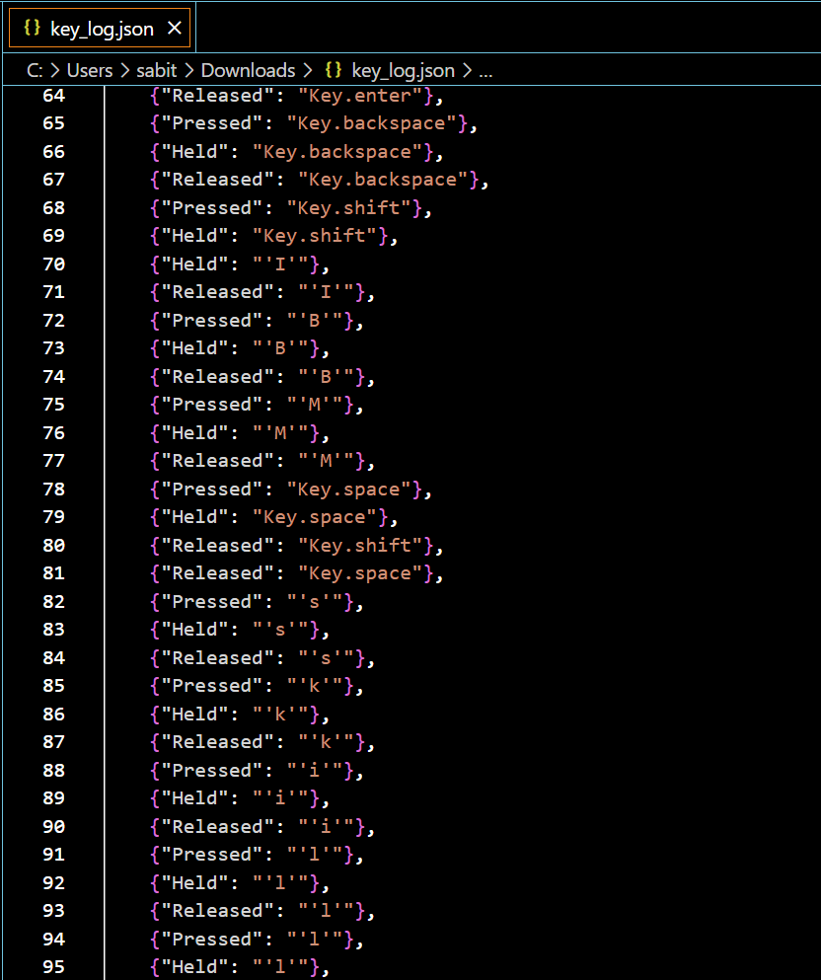
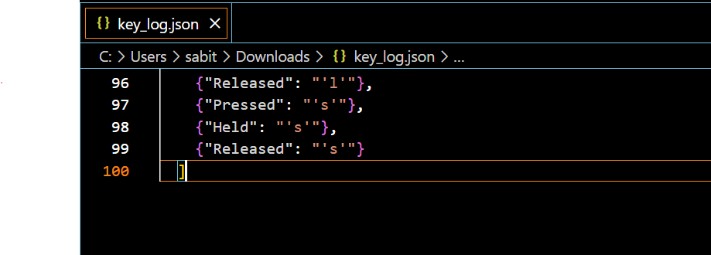

Slide 10
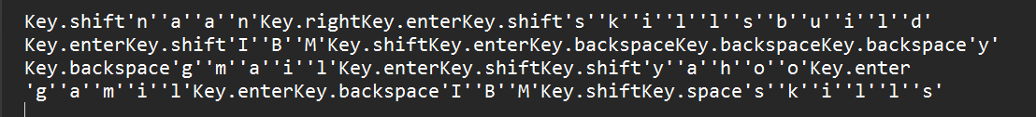
Key_log file

Slide 11
Conclusion
Key Points:
The keylogger application captures and logs keyboard events in real-time, bolstering security monitoring efforts.
Real-time monitoring facilitates prompt detection of suspicious keystrokes, enhancing cybersecurity measures.
Challenges Faced:
Ensuring compatibility across different operating systems.
Addressing privacy concerns associated with keystroke logging.
Potential Improvements:
Enhance logging features with timestamping and event categorization.
Implement robust privacy measures to safeguard user information.
In conclusion, while the keylogger application offers valuable security monitoring capabilities, addressing compatibility and privacy concerns, along with implementing necessary enhancements, are crucial for its effectiveness in the long term.

Slide 12
Future scope
Potential Enhancements:
Integration of additional data sources: Explore incorporating data from diverse sources such as network activity, application usage, or biometric data for comprehensive monitoring.
Algorithm optimization: Fine-tune the keylogger algorithm for better performance and efficiency, considering factors like resource utilization and detection accuracy.
Expansion to cover multiple platforms: Extend the keylogger application's compatibility to cover a wide range of operating systems and devices, ensuring comprehensive security monitoring.
Integration of emerging technologies: Explore the integration of emerging technologies like edge computing or advanced machine learning techniques for enhanced threat detection and analysis.
By pursuing these potential enhancements and expansions, the keylogger application can evolve into a robust and versatile security monitoring solution, capable of addressing evolving cybersecurity challenges effectively.

Slide 13
References
Brownlee, Jason. "How to Develop a Keylogger in Python." Machine Learning Mastery, 2020. [Online]. Available:.https://machinelearningmastery.com/how-to-develop-a-keylogger-in-python/
McKinney, Wes. "Python for Data Analysis." O'Reilly Media, 2017.
Pedregosa, F. et al. "Scikit-learn: Machine Learning in Python." Journal of Machine Learning Research, vol. 12, pp. 2825-2830, 2011.
Van Rossum, Guido, and Drake, Fred L. "Python 3 Reference Manual." CreateSpace, 2009.

Slide 14
THANK YOU

